Slide 1


Bhavan’s Vivekananda College Of Science , Humanities & Commerce
TOPIC: MONTHLY SUNSPOT DATASET
29:MOVVA KALYANA PADMAVATHI

Slide 2

Description: This dataset describes a monthly count of the number of observed sunspots for just over 230 years(1749-1983).The units are a count and there are 2,820 observations.
Objective:
For sunspot dataset , predict for next 10 years .Split to train/test and
report MAPE and AIC.

Slide 3

Data and Data Quality Check Number of instances:2,820 Number of Attributes:2(Months,Sunspots) Missing Attribute Values:None

Slide 4
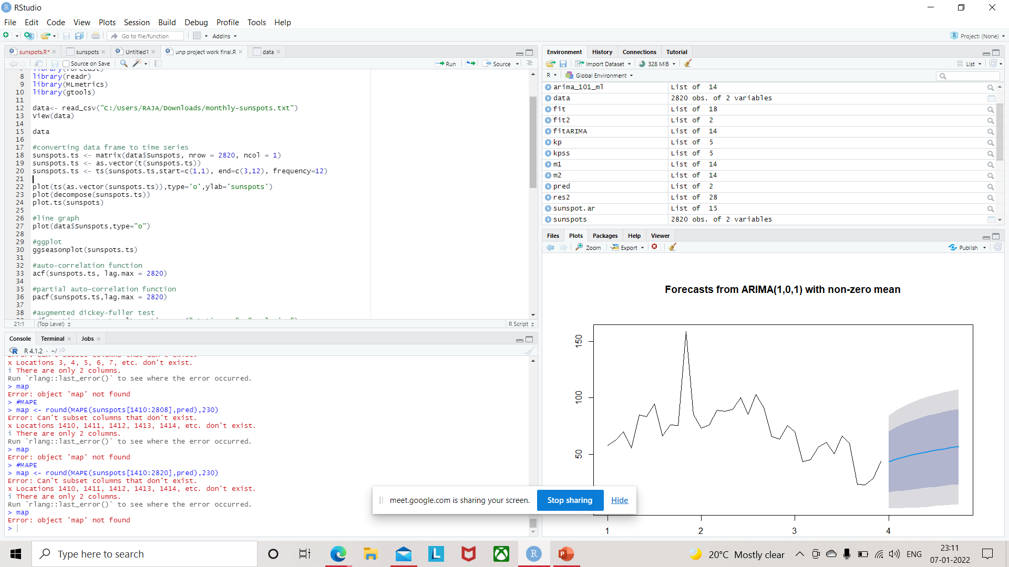
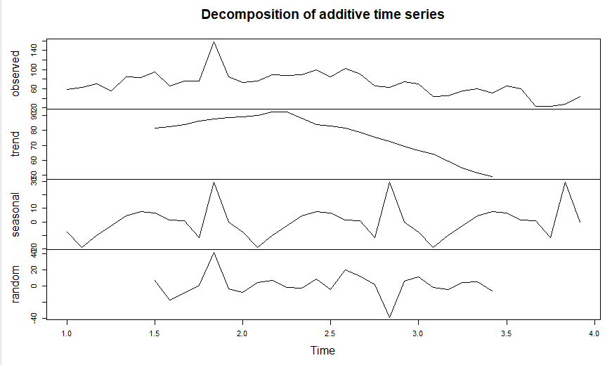
Converting data frame to time series Decomposition Plot
plot(decompose(sunspots.ts))

Slide 5
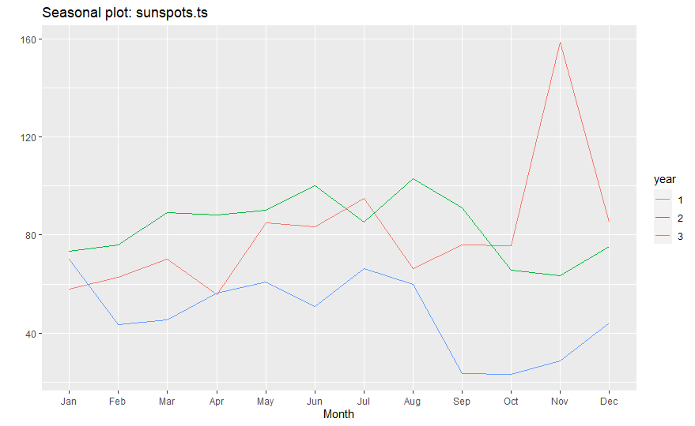
Seasonality Plot ggseasonplot(sunspots.ts)

Slide 6

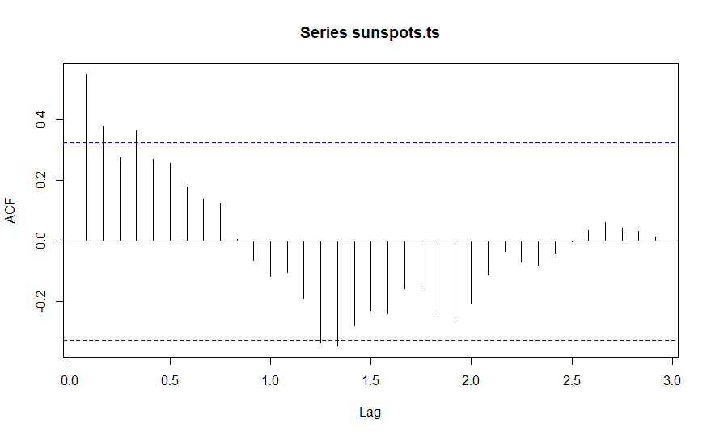
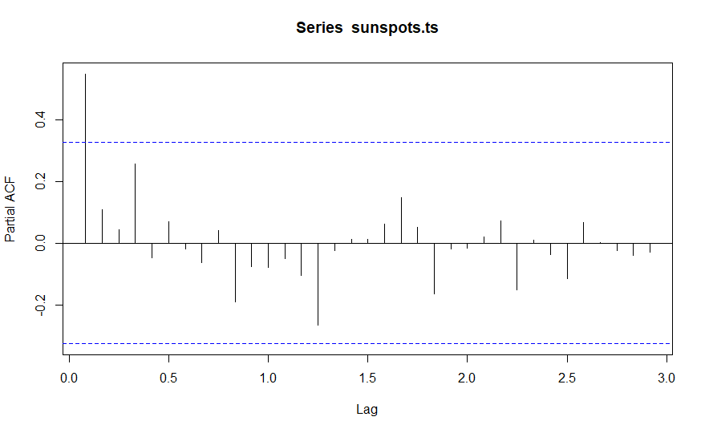
Auto correlation function and partial auto correlation function

Slide 7
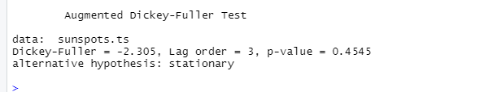
EDA Insights Augumented dicky-fuller test(ADF) test for checking stationary in the time series.

Slide 8
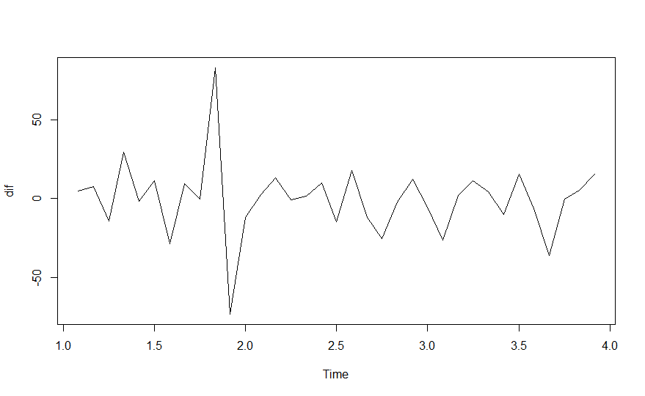

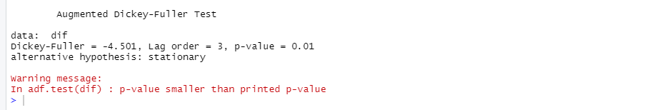

Difference in the timeseries to check the seasonality

Slide 9
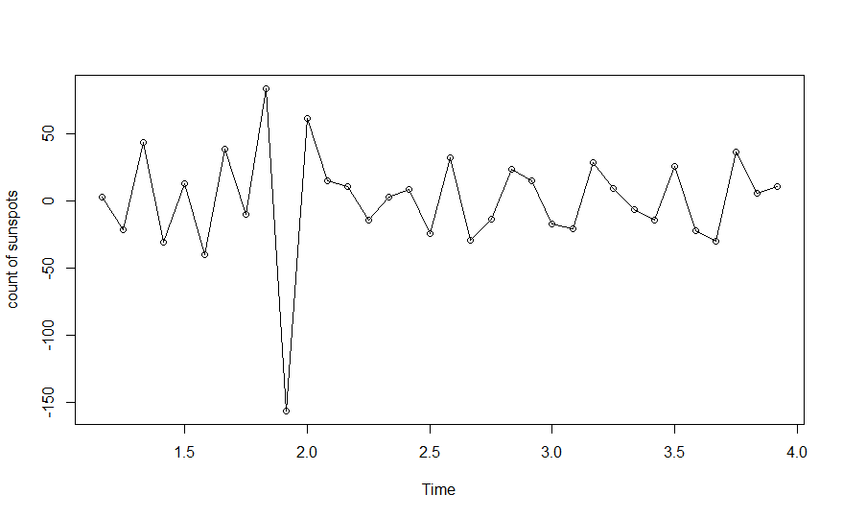

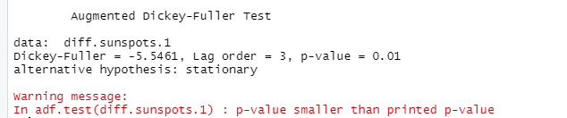
Difference in the time-series to check the seasonality
When D=1

Slide 10
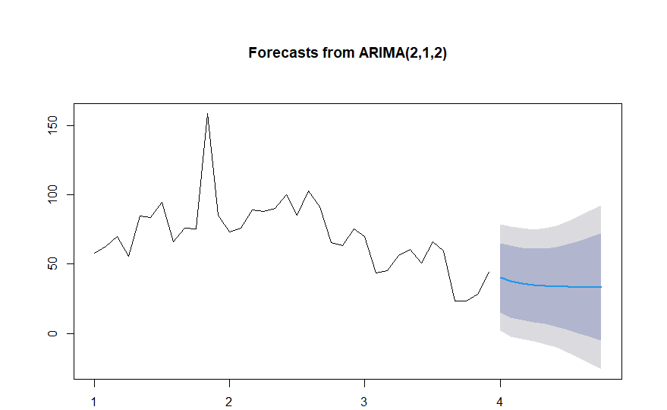
Arima and Prediction
We Predicted next 10 years sunspots using 230 years sunspots data. MAPE(Mean Absolute Percentage Error)= 0.3521375

Slide 11


This Photo by Unknown Author is licensed under CC BY

